Slide 1
AuE 8230 Autonomy: Science and Systems Critical Analysis of ROS, ROS-I and ROS2
Chinmay Samak

Slide 2



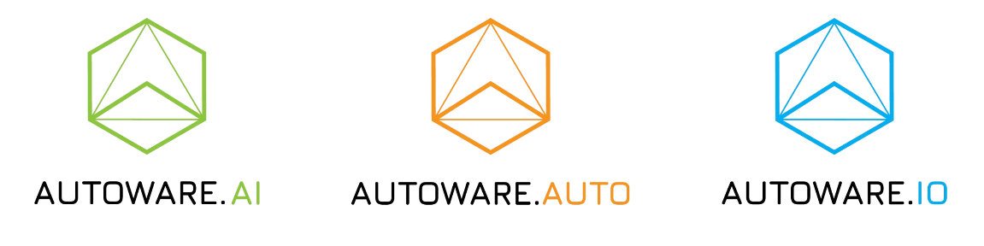


Introduction to ROS and its variants
NOT an OS – rather an SDK/middleware/meta-OS targeted towards robot software development
Provides a message-passing system to share information
Offers out-of-the-box support to launch, debugging, logging, visualization & playback tools
Provides building blocks for drivers, algorithms (perception, planning, control), user-interfaces, etc.
Connects to a global community of students, hobbyists, researchers, MNCs, govt. agencies, etc.
Adopted and modified to many variants for optimal performance and application-specificity
https://www.ros.org/blog/ecosystem/

Slide 3
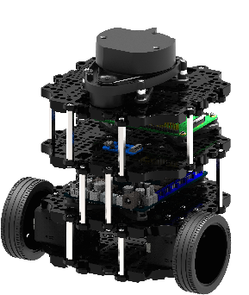
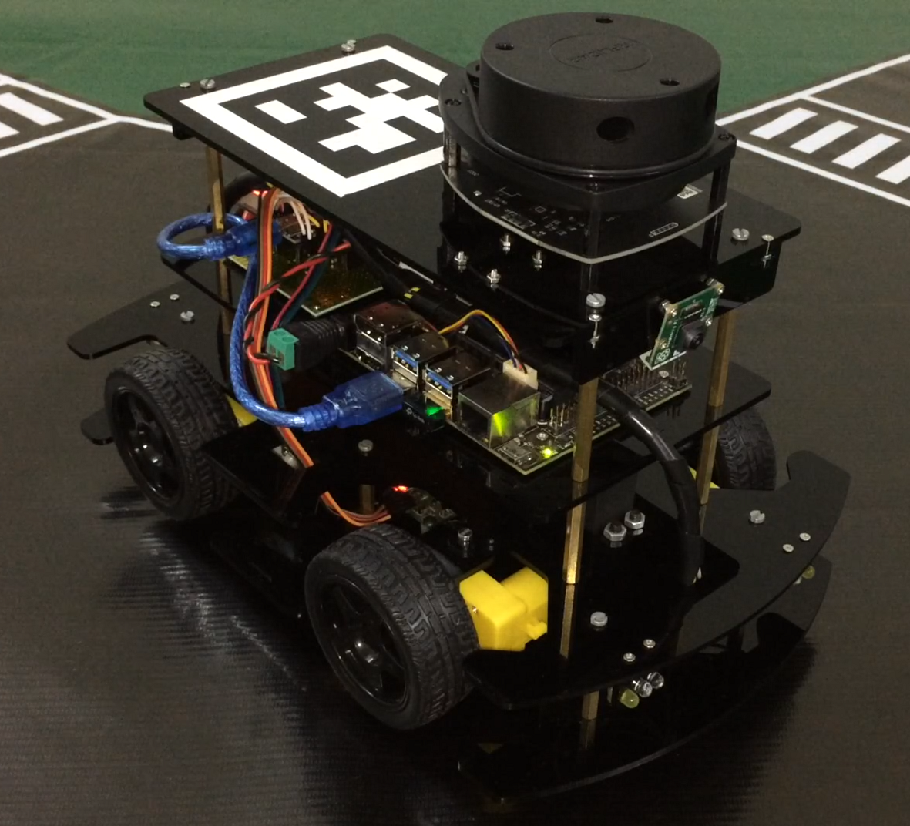
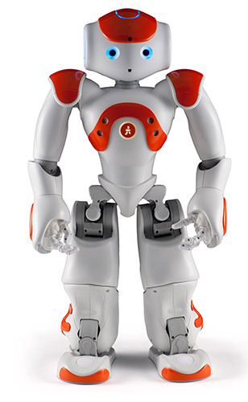

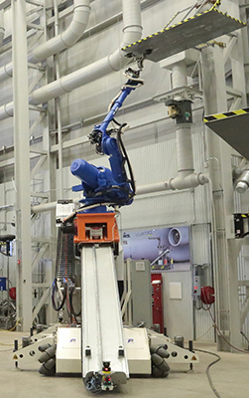
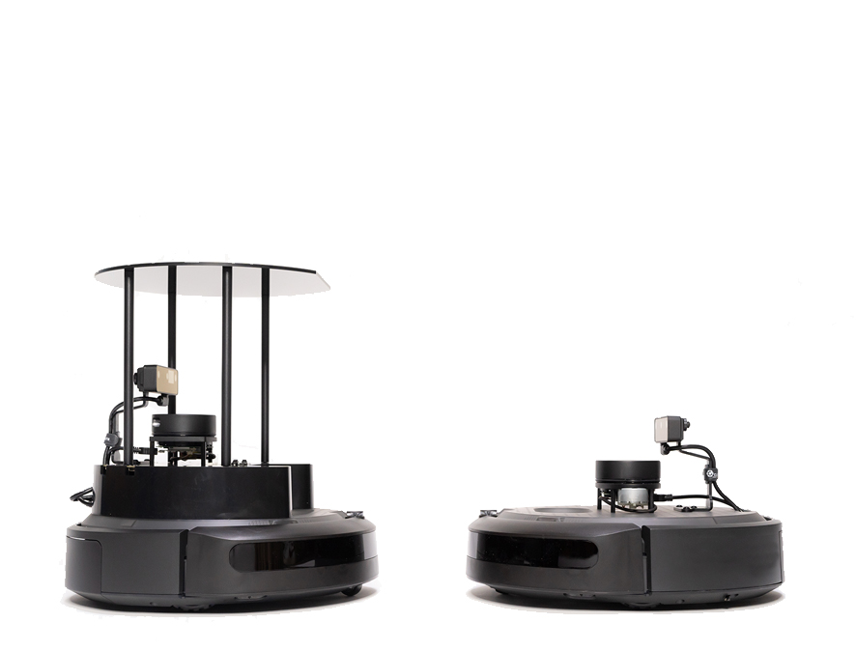
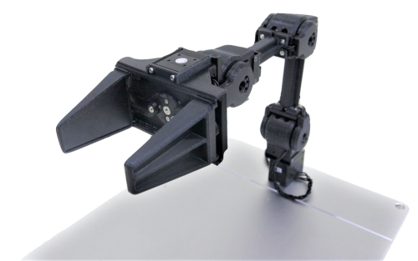
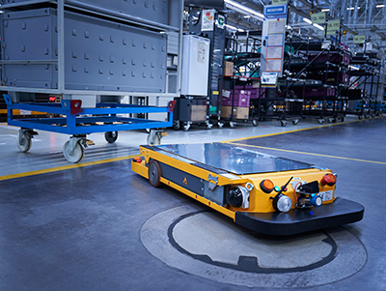
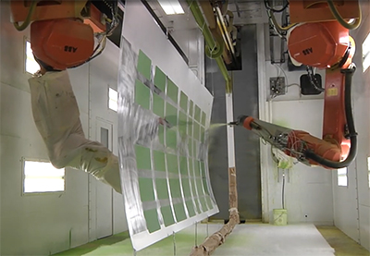
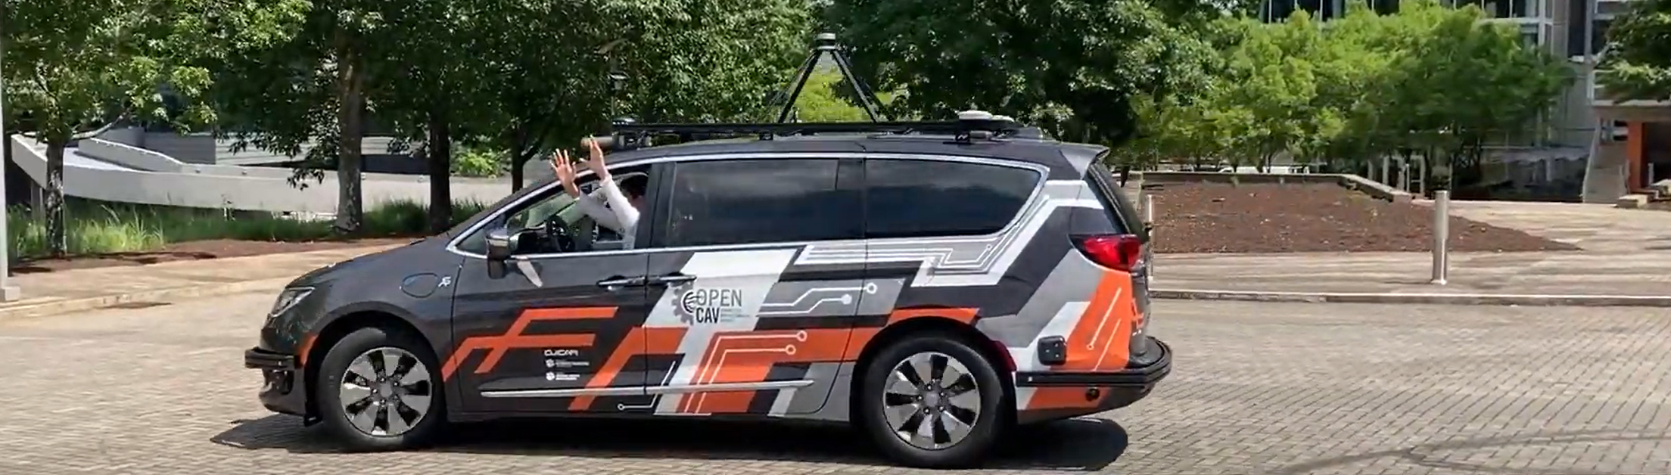
Which kind of robots use which system?
Frame transformations (rotations and translations)
Serial chain manipulators
Parallel chain manipulators
Kinematics & differential kinematics
Frame transformations (rotations and translations)
Serial chain manipulators
Parallel chain manipulators
Kinematics & differential kinematics
Frame transformations (rotations and translations)
Serial chain manipulators
Parallel chain manipulators
Kinematics & differential kinematics
https://robots.ros.org/
https://en.wikipedia.org/wiki/Robot_Operating_System
https://www.automate.org/industry-insights/ros-industrial-for-real-world-solutions
https://www.theconstructsim.com/a-list-of-robots-running-on-ros2/

Slide 4
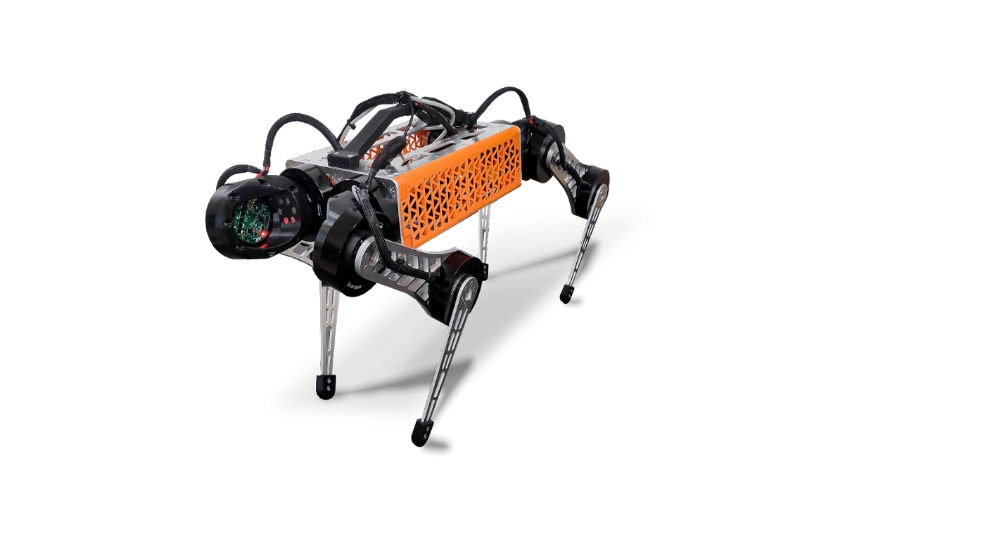
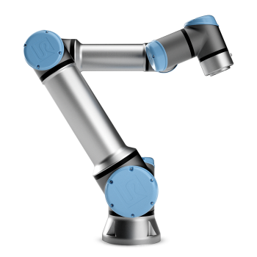
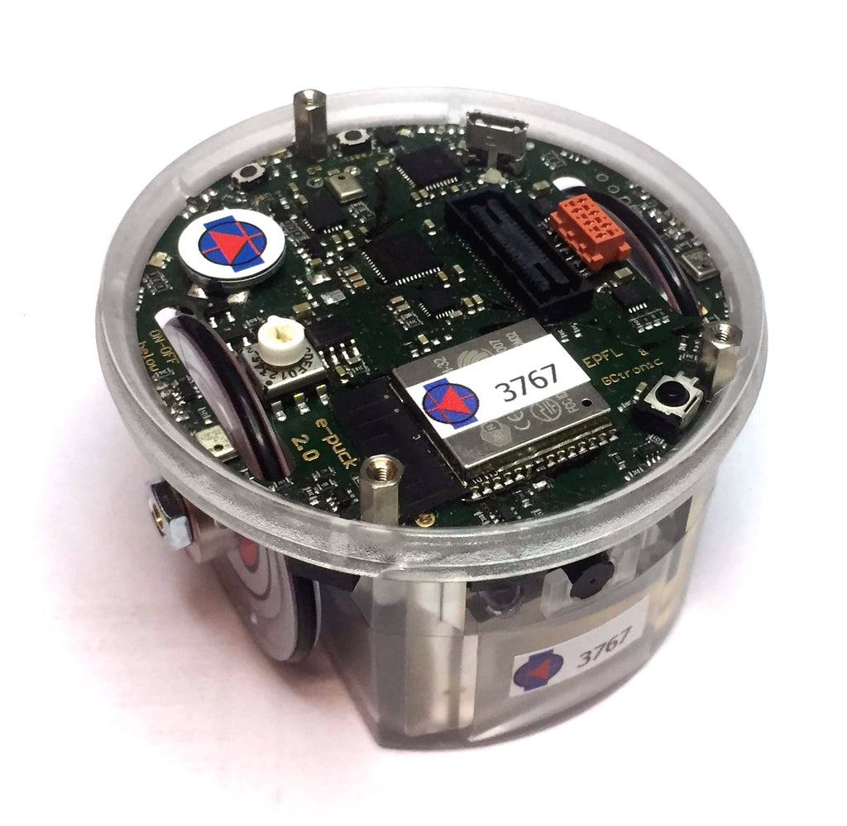
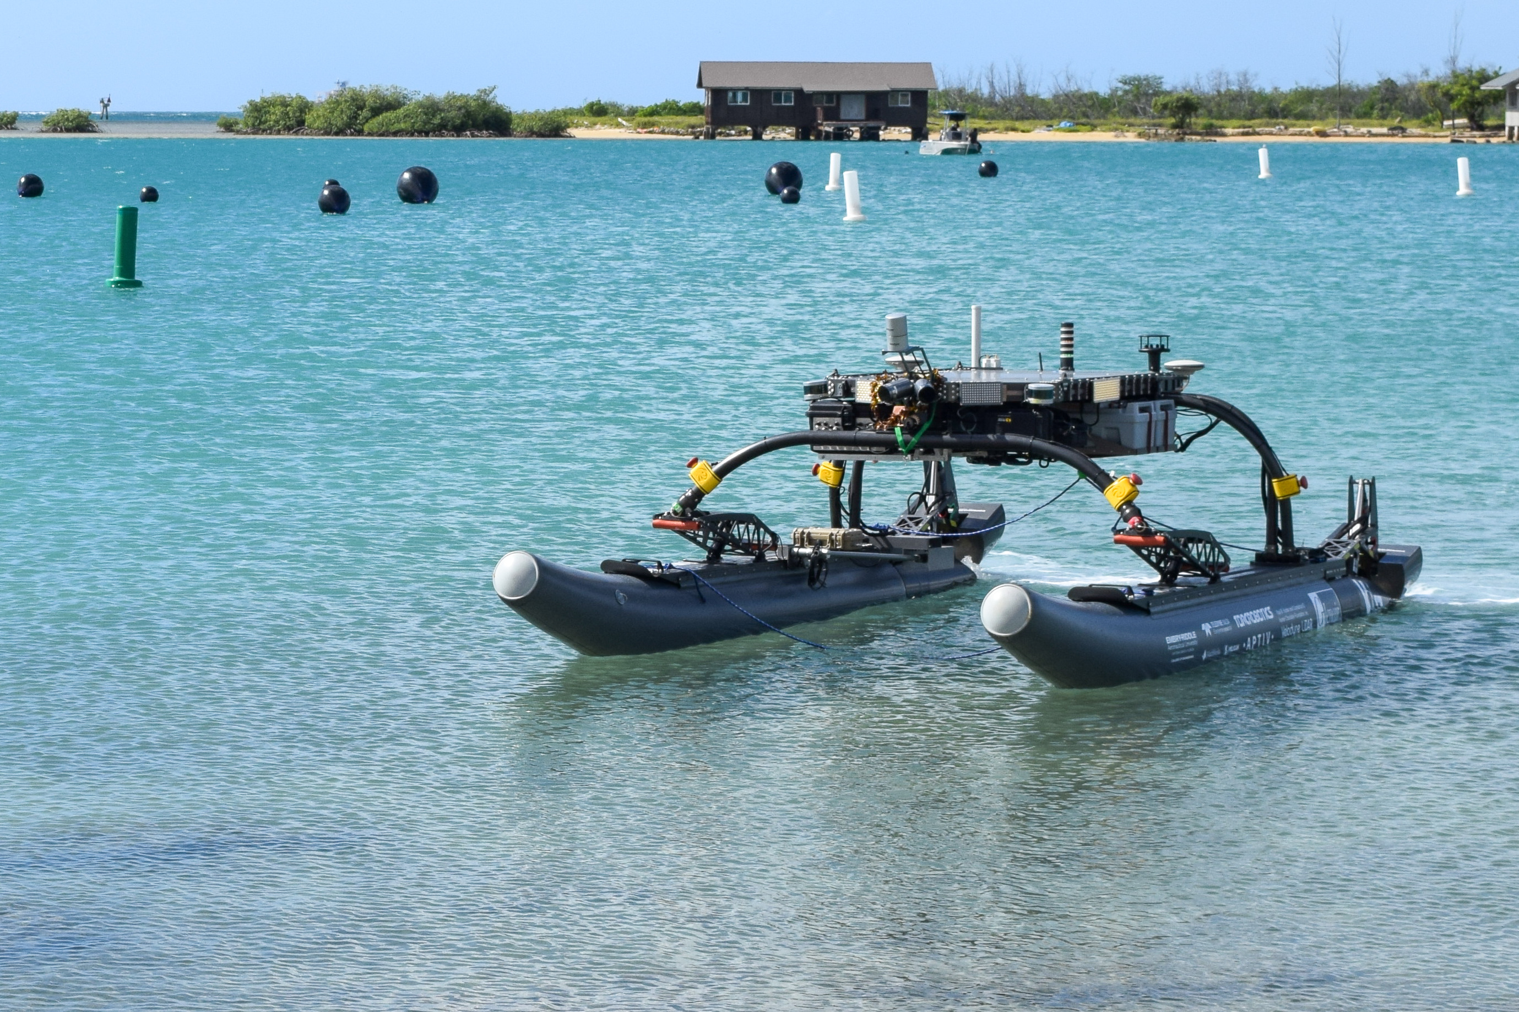
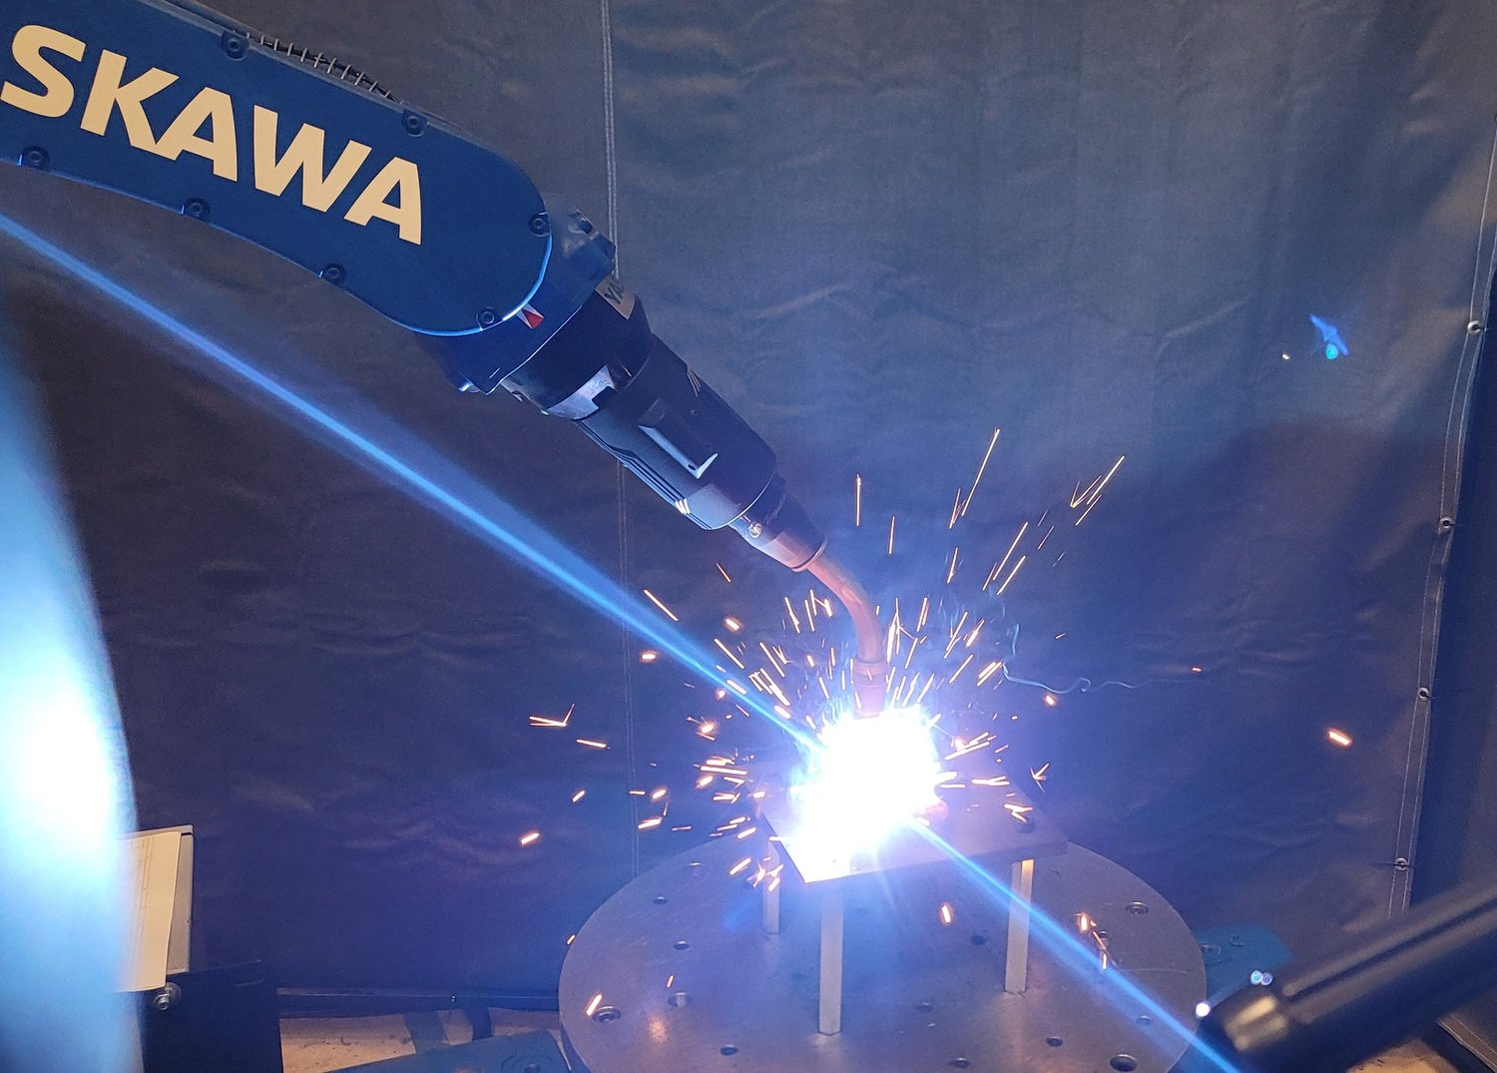
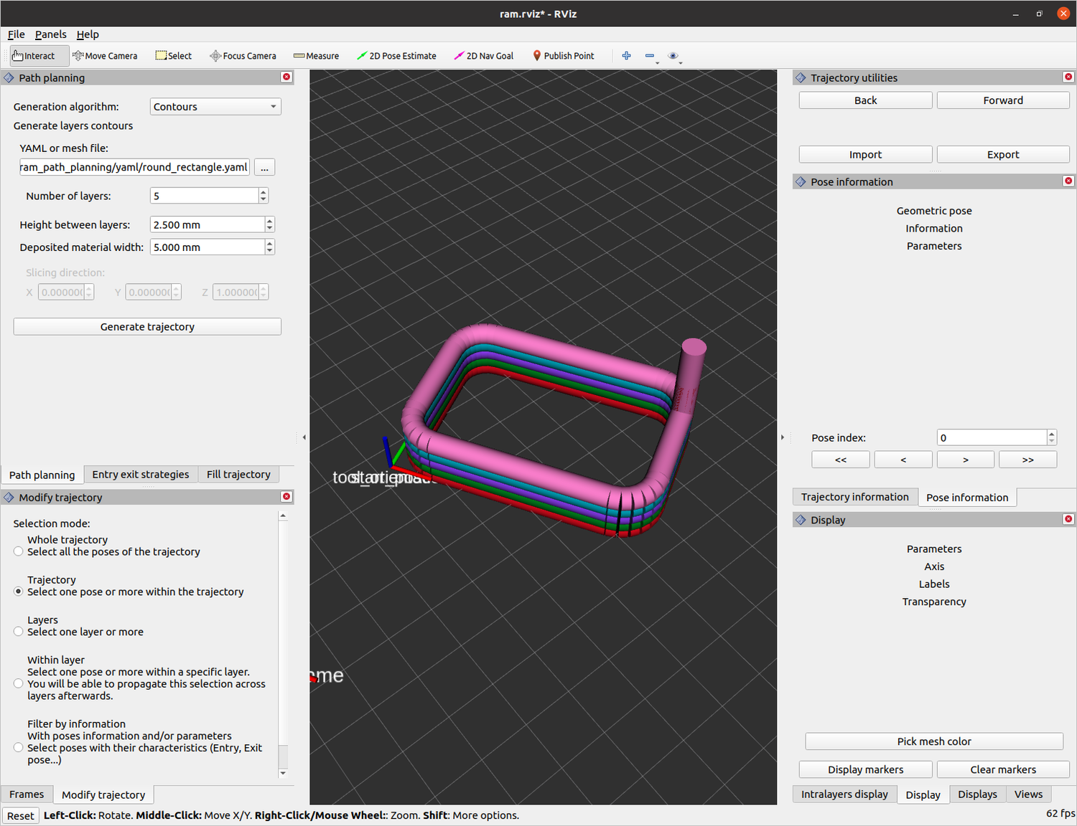
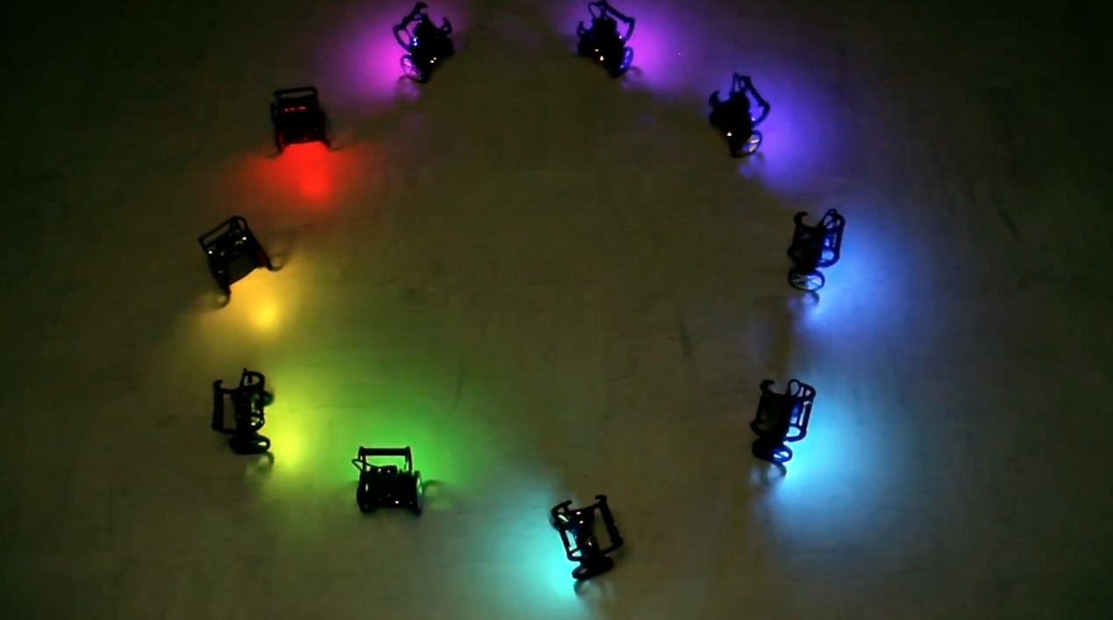
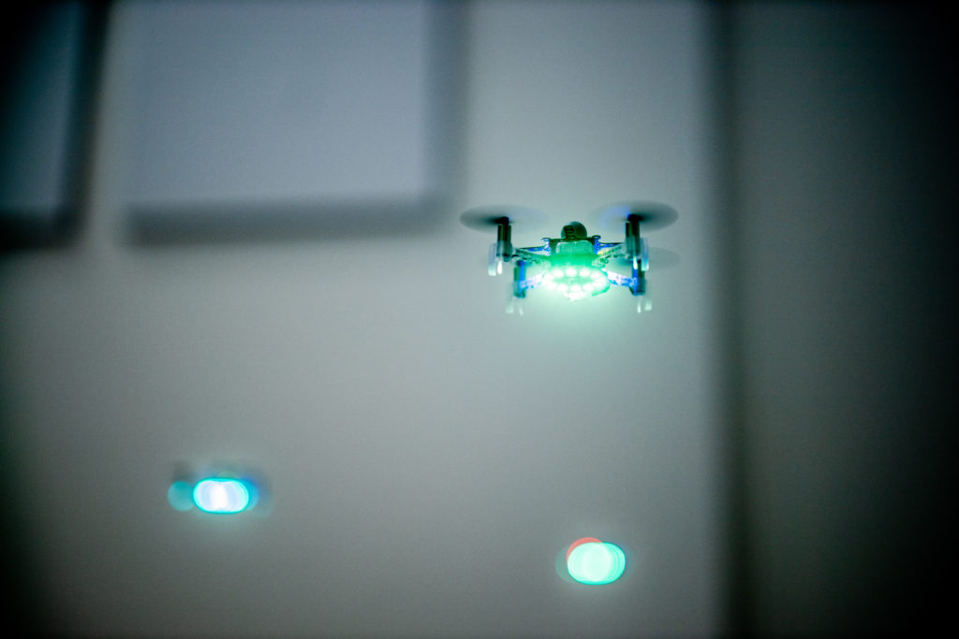
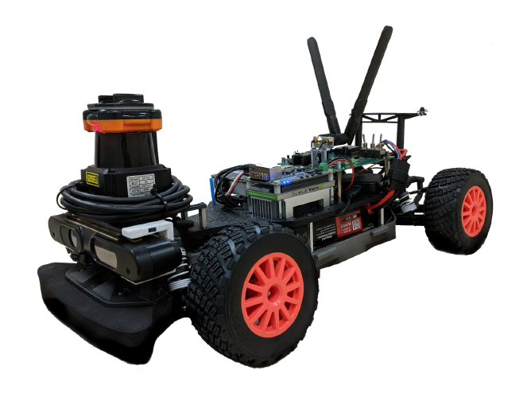
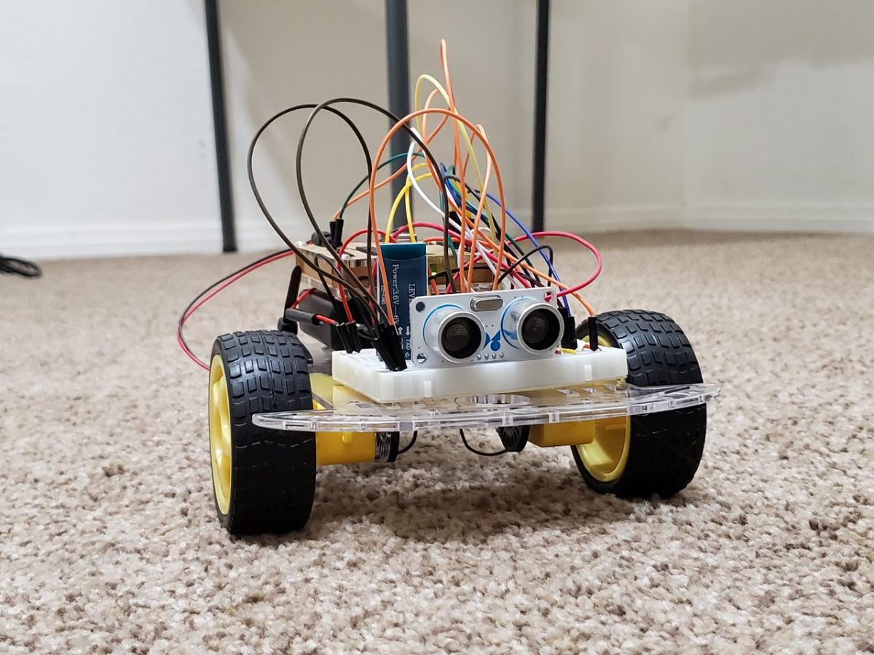
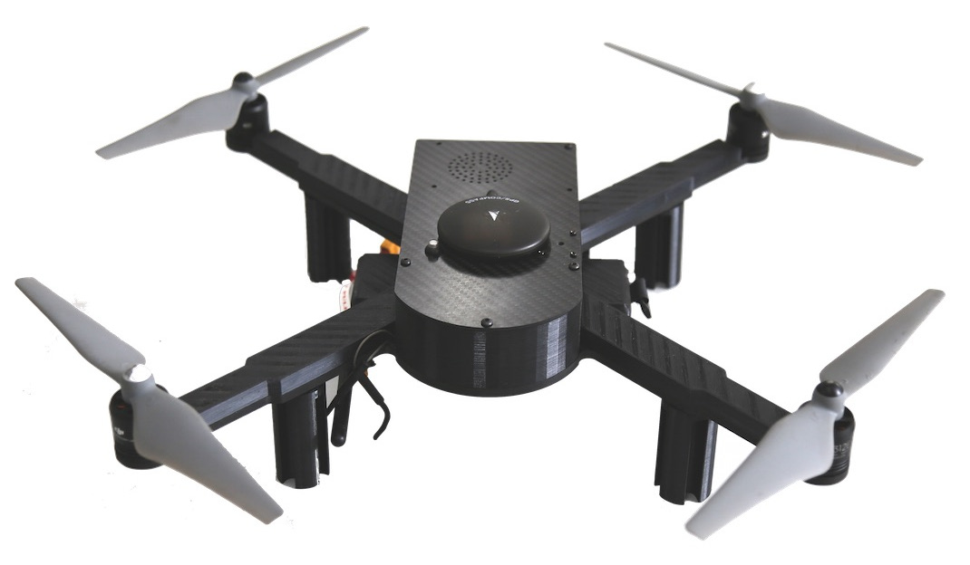
How are they deployed?
Hobby projects
Robotics competitions
Educational tools
Academic research
Industrial automation
Product development
Additive manufacturing
Industrial research
Educational tools
Academic research
Migrating from ROS to ROS2
https://sites.google.com/view/opencav/
https://f1tenth.org/
https://robotx.org/
https://rosindustrial.org/news
https://youtu.be/-6yAk05et1Q
https://wiki.ros.org/Industrial/Roadmap
https://www.theconstructsim.com/a-list-of-robots-running-on-ros2/
https://bettstetter.com/swarmalatorbots/
https://bettstetter.com/drones-that-sync-and-swarm/

Slide 5
What ancillary support resources are available?
Documentation
https://wiki.ros.org/
Questions & answers
https://answers.ros.org/questions/
Support
http://wiki.ros.org/Support
Discussion forum
https://discourse.ros.org/
Documentation
http://wiki.ros.org/Industrial
Installation guide
http://wiki.ros.org/Industrial/Install
Tutorials
http://wiki.ros.org/Industrial/Tutorials
Discussion forum
https://discourse.ros.org/c/ros-industrial
Bug/feature tracking
https://github.com/ros-industrial/ros_industrial_issues
Documentation
https://docs.ros.org/en/foxy/index.html
Installation guide
https://docs.ros.org/en/foxy/Installation.html
Tutorials
https://docs.ros.org/en/foxy/Tutorials.html
https://docs.ros.org/en/foxy/How-To-Guides.html
Concepts
https://docs.ros.org/en/foxy/Concepts.html
Support
https://docs.ros.org/en/foxy/Contact.html

Slide 6
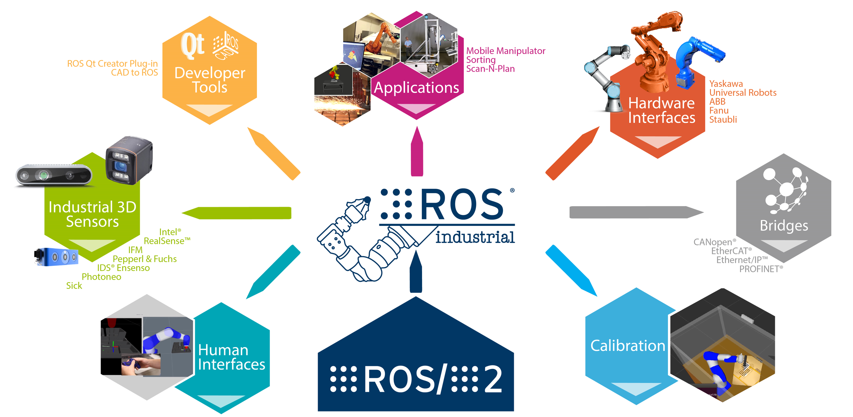
By what features can they be differentiated?
Centralized (master-based) node architecture
C++ 03/11, Python 2
Supported on Linux & macOS
Custom serialization format
Single node in a process
Launch files in XML with limited functionalities
Simple message
Industrial robot client
Industrial calibration
Vendor specific packages
Robot driver specification
Software quality assurance
Distributed (peer-to-per) node architecture
C++ 11/14/17, Python 3.5
Supported on Linux, macOS, Windows, RTOS
Based on data distribution service standard
Multiple nodes in a process
Launch files in Python enabling complex logic and conditioning
https://answers.ros.org/question/287470/what-is-the-difference-between-ros-and-ros2/
https://www.theconstructsim.com/infographic-ros-1-vs-ros-2-one-better-2/
https://www.generationrobots.com/blog/en/ros-vs-ros2/
http://design.ros2.org/articles/changes.html

Slide 7
How to decide which one to use?
After analysing the key differences between the 3 ROS variants, depending upon project requirements and application(s), one may choose to use ROS/ROS-I/ROS2 based on the following considerations:
Beginners and students
Hobby/educational projects
Rapid prototyping
Stable packages & debugging tools
Community support
Complete and detailed tutorials
Robot/hardware drivers
Developer tools
Industrial calibration
Human machine interfaces
Industrial applications
Enterprise scale deployment
Consortium membership benefits
Computer professional learners
Robot security
Real-time control
Minimal dependencies
Better portability
Greater reliability & persistance

Slide 8
Resources and References
Quigley, Morgan & Conley, Ken & Gerkey, Brian & Faust, Josh & Foote, Tully & Leibs, Jeremy & Wheeler, Rob & Ng, Andrew, 2009, “ROS: an open-source Robot Operating System”, ICRA Workshop on Open Source Software, 3
Edwards, S.M., 2011, “Leveraging the Open Source Robot Operating System (ROS) for New Industrial Applications” Robotics Summit, Robotic Trends Virtual Conference Series, September
Macenski, Steve & Foote, Tully & Gerkey, Brian & Lalancette, Chris & Woodall, William, 2022, Robot Operating System 2: Design, Architecture, and Uses In The Wild, 10.48550/arXiv.2211.07752
Overview: https://ubuntu.com/robotics/what-is-ros
ROS Documentation: http://wiki.ros.org/
ROS-I Documentation: https://rosindustrial.org/
ROS2 Documentation: https://docs.ros.org/en/foxy/index.html

